Slide 1
There were a lot more steps, but keeping it high level should be sufficient. So you should just add these steps to what we already have
Data cleaning steps to be added.
Total Funding Amount is calculated by summing up NIH Funding Amount, Fed Funding Amount, and Non Fed Amount
Total Cost is calculated by adding up Fed Direct cost, Non Fed direct cost, and NIH Direct Cost
Each project has many diagnosis areas. So, a new column is created by joining all the diagnosis areas for each Project and Profile combination. [Query - Group by Project ID, Profile ID and concatenate Diagnosis Areas]

Slide 2
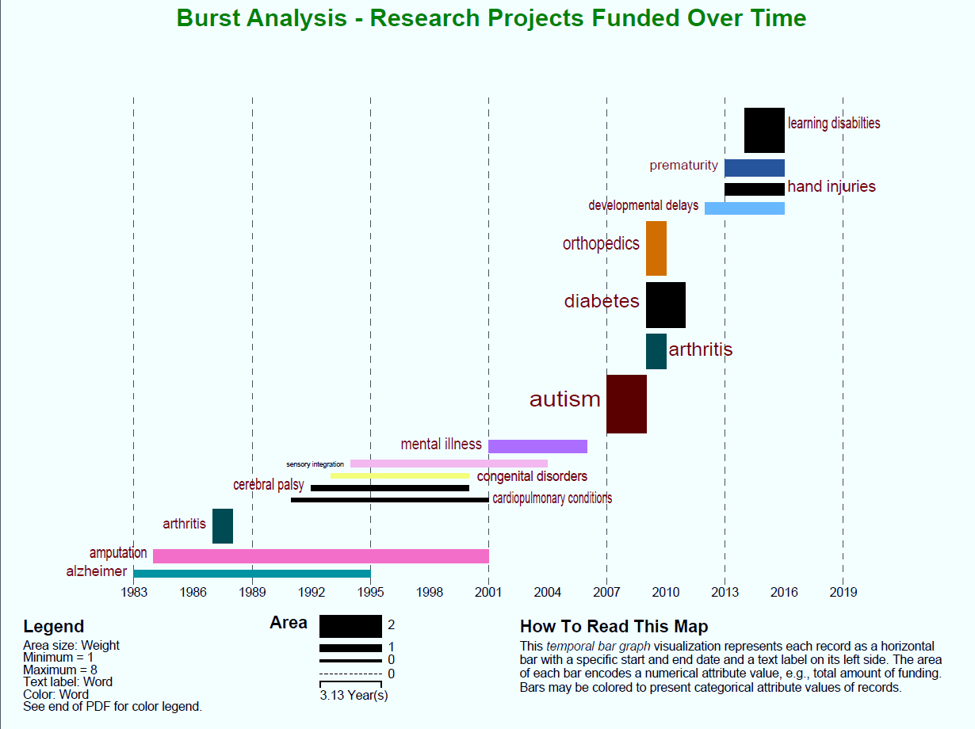
1.2 Temporal Visualization
For Temporal analysis, Sci[2] was used to normalize, tokenize and remove stopwords from diagnosis description field. Main objective of burst analysis is to highlight the consistent persistence or longevity of various research areas funded by AOTF over a period of time. Burst analysis helps to visualize how persistent AOTF has been with a particular research area over a period of time. In order to understand the kind of diagnosis funded over a period of time, burst analysis, using Sci2, has been combined with a bar graph visualizing number of different research projects funded over the span of 1982-2016. Burst analysis have been restricted by using a Gamma of 0.55 and a density scaling of 2.0 in Sci2 burst detection algorithm. Diagnosis keywords highlighted in burst analysis have been used as an input to Tableau dashboard. This dashboard highlights the number of research projects funded over each year. These graphics are combined to show how various diagnosis were researched over a period of time.
2.1 Temporal Visualization
Below graph highlights what topics have been persistently funded during various time periods. For each topic within burst analysis, number of research projects funded over each year have been highlighted. A total of 31 different diagnosis have been funded over the past 30 years, and 14 topics have been picked by the burst analysis algorithm. These 14 topics have been used as in input to tableau visualization. As you could see below, burst analysis has been combined with Tableau dashboard. The most funded areas are Others (116), Autism (91), Stroke (82), Sensory Integration, and Brain Injuries. During 1980’s & 1990’s, Amputation related research projects have been funded the most. During 1990’s, Sensory processing disorders related projects have also been equally encouraged by AOTF. AOTF funded projects have increased by 4 times from 1980’s to 90’s, while the funding amount increased from $1.12 Mil to $30.1 Mil during this period. During 2000’s – Autism related research projects have been funded the most, followed by Heart stroke related projects. There were a total of 272 different research areas covered during this decade, and close to $64.7 Mil of funding granted (almost of twice the amount funding compared to 1990’s). New research areas funded the most during 2000’s – Orthopedics and Neurodegenerative diseases. After 2010, Autism and Heart related research projects have still been the most AOTF funded research areas. Breadth of diagnosis areas covered has widened quite a bit. There is a total of $57.8 Mil funding provided between 2010 and 2016. New research areas funded during this time are – Burns and HIV/AIDS.

Slide 3
3 DISCUSSION
3.1 Temporal Analysis
Alzheimer and Amputation have been persistently sponsored over the first two decades. Sensory Integration and Cerebral Palsy areas have been funded consistently during 1990’s and early 2000’s. As more and more research areas are funded, there are very limited diagnosis areas that are consistently funded. A large of number of projects in Autism area have been funded in 2007. Most of the research projects covered multiple diagnosis areas. There are no specific fields to highlight how much of the funding went towards which area. So, it was difficult to use funding amount in temporal analysis. Results of temporal analysis should be overlaid with various diseases that primarily hit during that period. Overlaying this disease information with AOTF research areas could explain if AOTF research projects were reactive or proactive in nature. Also, it will highlight how relevant research areas have been with the conditions/health care issues prevalent during those times. Peer comparison could be interesting. Comparing AOTF research areas and funding amounts to other organizational funded research areas will explain if there is funding overload in some areas, or lack of funding. Such analysis will also highlight if the research areas are complementary or supplementary in nature with the industry.

